Slide 1
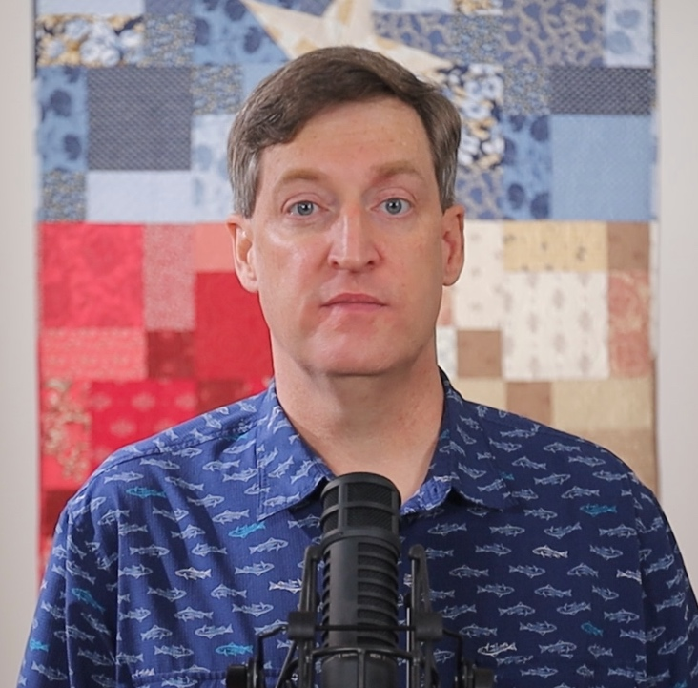
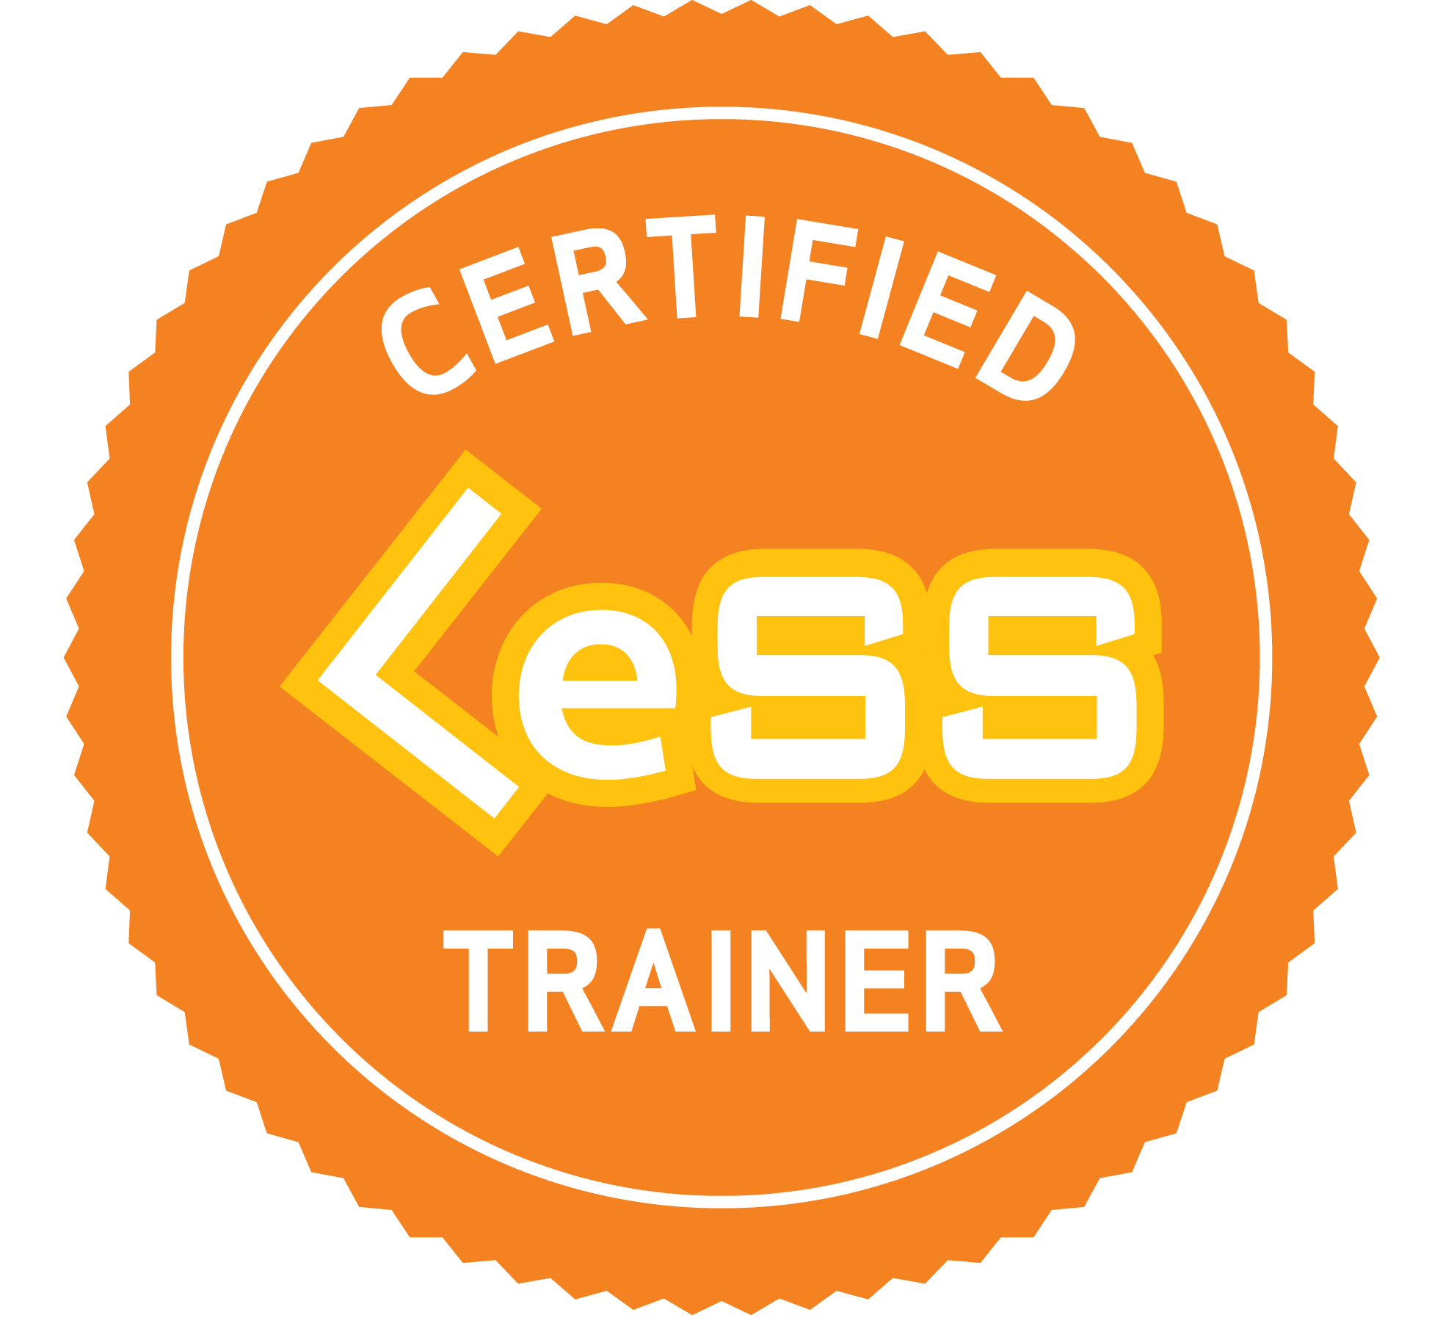

James Carpenter
Consulting & Training

Slide 2
Why LeSS?
Traditional large groups are complicated — not because they must, but because their organizational designs, based on local optimization, create an illusion of ‘necessary’ complexity.

Slide 3
Help Is Available
Agile Carpentry helps companies use
LeSS to shape organizations that are simpler, more adaptive and focus delivery on maximising value, while enriching the human experience at work.
Greater
Adaptiveness
Greater
Customer value
Greater
Revenue

Slide 5

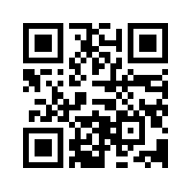
https://agilecarpentry.com/blog/learning-about-less/

Slide 6

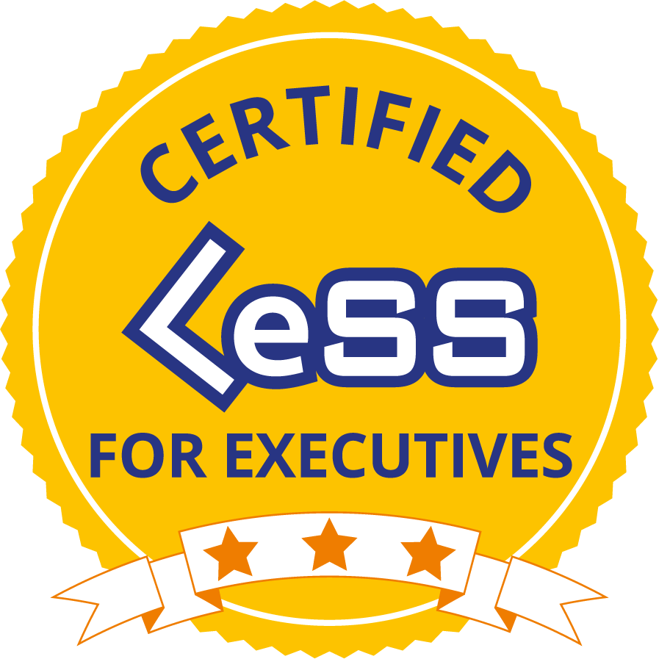
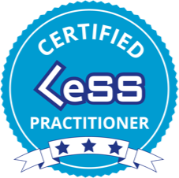
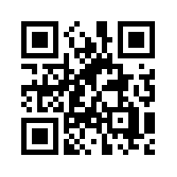
Stand-Alone Training
Certified LeSS for Executives
Certified LeSS Practitioner
Informed Consent Workshop
Consulting Services
Training and Launching Teams
Coaching Through First Sprint
Long-Term Coaching
Remote Advisor
Cadenced In-Person Trips
Translation of LeSS books
https://agilecarpentry.com/services/

Slide 7
Seeking To Help
Agile Carpentry is seeking to help executives of large and mid-sized product development organizations who have the courage to consider redesigning their organizations to achieve greater value delivery.

Slide 8
Company & Community
Best vetted agile trainers and coaches in the world.
LeSS marketing umbrella, certified courses, books, knowledge base, and related support infrastructure.
Depth of bench within the community.

Slide 9
Backup Slides

Slide 10


CLP Instructional Design Pattern
System Modeling
LeSS
Specifics
Agnostic of any specific framework, just the “physics” of the work.
More concrete potential implementation specifics to help ground abstract theory.
Thinking Gorilla
© Joshua J. Cotten,
Unsplash
highest-level adaptiveness in the service of learning & delivering highest-level “value”

Slide 11

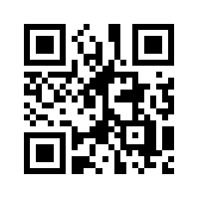
In-Person Anywhere!
Take the survey
My LinkedIn is here too
https://agilecarpentry.com/clp/global/

Slide 12
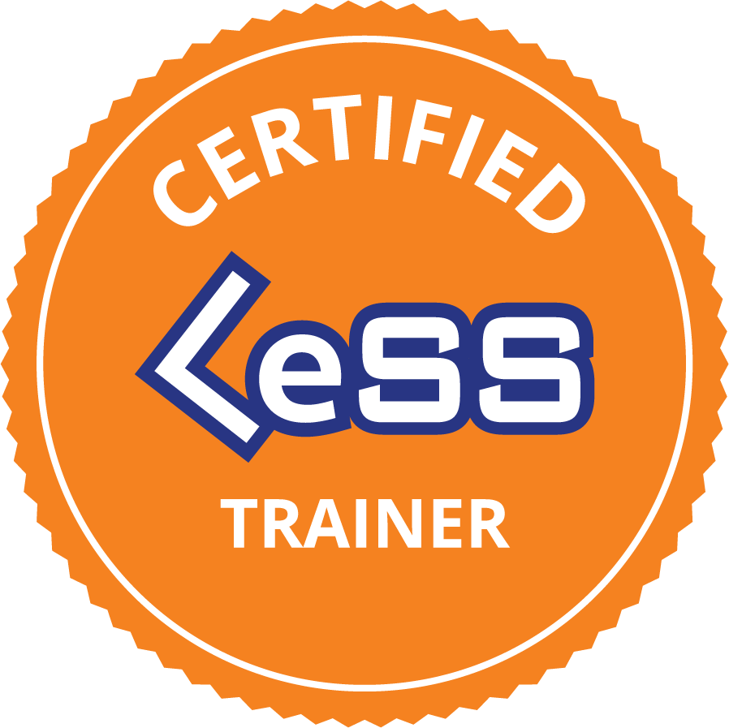
Training Services
Certified LeSS Practitioner
Certified LeSS for Executives + Informed Consent Workshop
https://agilecarpentry.com/services/

Slide 13
Consulting Services
Facilitating Executive Off-Site
Training and Launching Teams
Coaching Through First Sprint
Long-Term Coaching
Remote Advisor
Cadenced In-Person Trips
https://agilecarpentry.com/services/

Slide 14
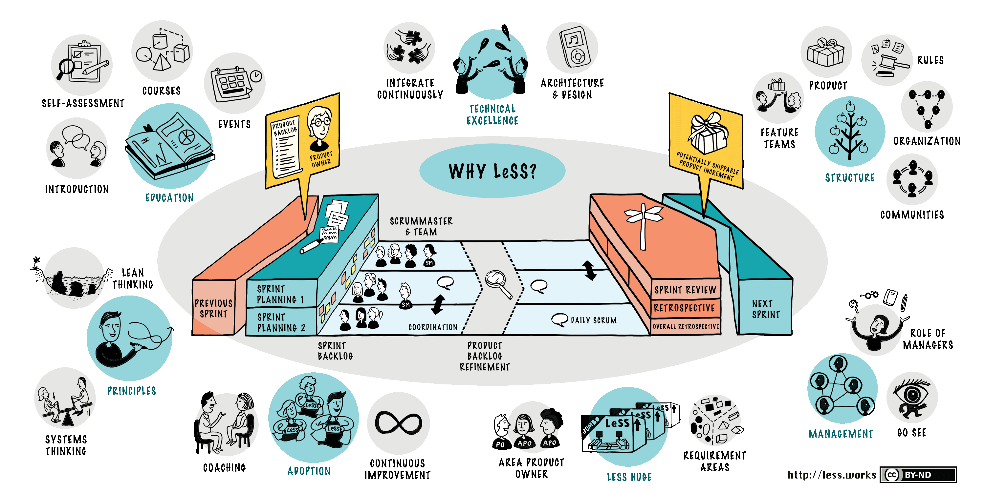
LeSS In Arabic* via Agile Carpentry
$Just Add Funding$
https://less.works
Key Relationships
Chairperson of translation at Notre Dame University in Beirut, Lebanon
All required LeSS Company relationships
Many others
Written Content
Course Pack
Slide Deck
System Variables
Case Study
Other
Live Captions
Arabic Table Discussions
* Or any other language

Slide 15

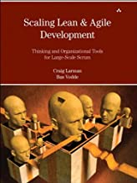

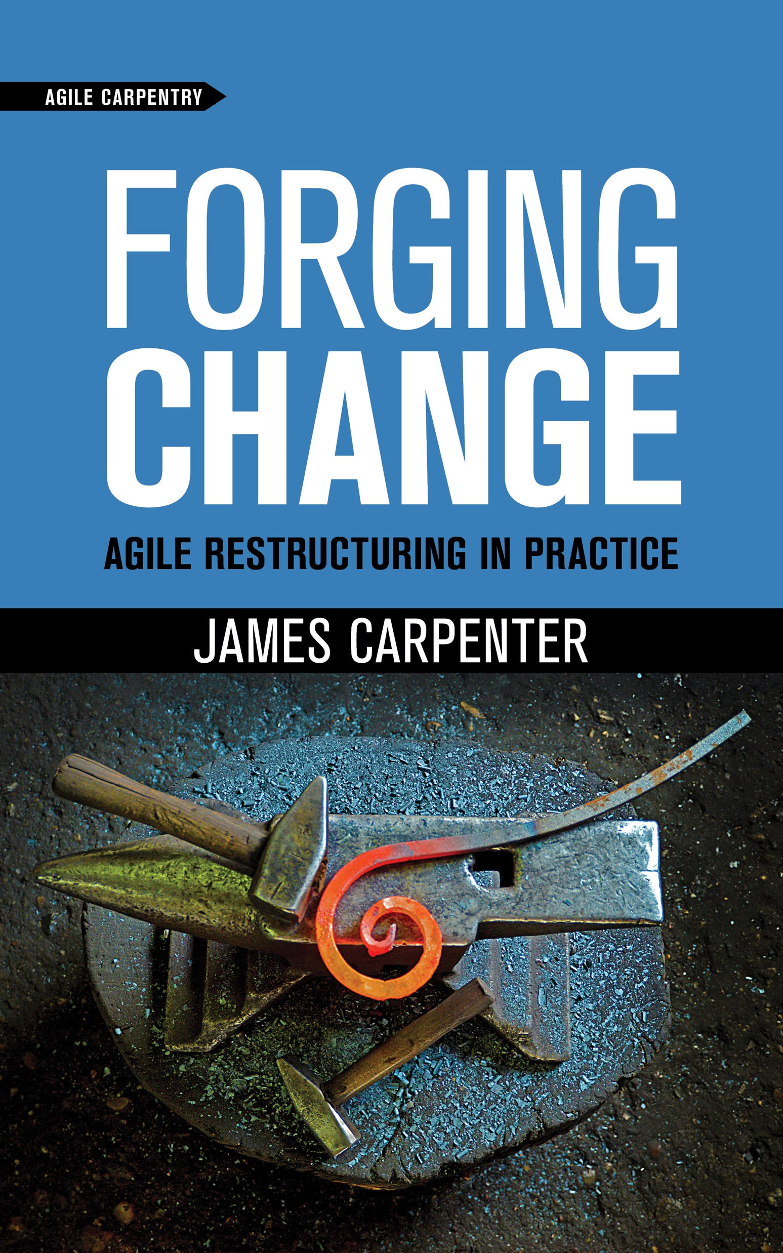

LeSS Books In Arabic* via Agile Carpentry
Addison-Wesley Conversations In-Flight
Funding Needed
Key Elements
Chairperson of translation at Notre Dame University in Beirut, Lebanon
Past publishing experience
Agile Carpentry publishing imprint
Addison-Wesley has determined Agile Carpentry has the depth of publishing experience required to be entrusted with translation rights.
* Or any other language

Slide 16
Example Internal Pitch Deck

Slide 17
What follows is a heavily redacted pitch deck used by an internal advocate at one potential client. Your own needs my vary, yet this may still provide useful seed content.
I have not worried much about formatting since you will likely need to apply your own in-house template anyway.
Most importantly, please reach out so I can help you influence whomever you need to influence.
Sincerely,
James Carpenter
Certified LeSS Trainer
832-677-7247
james@agilecarpentry.com
https://agilecarpentry.com

Slide 18
ACME Product R&D Agile Transformation Proposal

Slide 19
Agenda
Vision
Obstacles to the Vision
Strategy
Milestones
Budget
Role Change & Initial Investment

Slide 20
Vision
We desire to have a learning organization that delivers the highest value to our customers through a cohesive offering instead of individual products or components, as well as the ability to quickly adapt to our customers needs in a sustainable manner with improved forecast accuracy.

Slide 21
Obstacles to the Vision
Right people aren’t available
Functional silos
Time zone challenges
Component focus vs. customer-value focus
Multiple backlogs within a product
Lack of transparency
Unpredictable delivery

Slide 22
Strategy To Achieve The Vision
Start Small, But Not Too Small
Adopt a new way of working
Cross-functional teams organized around customer value that have the right people to make decisions
Change the mindset - start with leadership by providing leadership education which includes some key staff involved in the day-to-day
Determine initial set of teams organized around a whole-product, customer-value focus
Provide training and ongoing coaching for initial teams to put into practice
Expand to other teams when initial group is mature enough

Slide 23
Key Initial Milestones
ACME Product and R&D Leadership Education
Determine Scope of Initial Adoption and Teams
Initial Teams Have Been Trained
Initial Teams Have Been Launched
First Requirement Area is operating well enough to focus on launching next Requirement Area

Slide 24
Key Milestones
Initial Estimated Timeline
Q2 FY’** |  |  |  |  |  |  |  | Q3 FY’** |  |  |  |  |  |  |  |  |  |  |  |  |  | Q4 FY’**
June |  |  |  | July |  |  |  | August |  |  |  |  | September |  |  |  | October |  |  |  |  | November |  |  |  | December |  |  |  | January
W1 | W2 | W3 | W4 | W1 | W2 | W3 | W4 | W1 | W2 | W3 | W4 | W5 | W1 | W2 | W3 | W4 | W1 | W2 | W3 | W4 | W5 | W1 | W2 | W3 | W4 | W1 | W2 | W3 | W4 | W1 | W2 | W3 | W4 | W5
Initial Teams Trained & Launched
Launch Next Requirement Area
Prepare for ACME Product and R&D Leadership Education
Prepare and train initial teams
Guide maturation of initial Requirement Area (6 - 12 weeks typically)
Identify, prepare and train next set of teams.
Leadership Education & Determine scope of initial adoption and teams

Slide 25
Milestones
Leadership Education – Learning Objectives
1. Principles & Management Implications
Empirical Process Control for the Entire Organization
Lean Thinking
Systems Thinking: From Local to Global Optimization
Whole-Product Focus: Group and Role Impacts
Customer Centric: Process and Group Impacts
2. Adoption
Adoption Principles
Getting Started
Growing Your Adoption
Culture Follows Structure
Job Safety, but not Role Safety
From Smallish to Huge
Multisite Adoption
3. Structure & Roles
What is your product?
Organizing around Customer Value and Feature Teams
Role of Managers
The Business-Driven Product Owner
Typical Organizational Structures and Patterns
Multisite Implications

Slide 26
Key Milestones
Determine scope of initial adoption and teams
Do the last day during the week of training
Clarifying product definition
Determining the product scope involved in the initial adoption
Determining the people involved in the initial adoption
Ensure team rules are understood and accounted for

Slide 27
Key Milestones
Initial teams have been trained
Preparation for training for identified initial teams
Conduct the training for initial teams

Slide 28
Key Milestones
Teams Have Been Launched
Teams have been formed
Teams have conducted 3 - 6 iterations (assume 2 week iterations)

Slide 29
Key Milestones
First Requirement Area is operating well enough to focus on launching next Requirement Area
Teams are focusing on Quality not Quantity (following DoD)
Teams are focusing on a shippable increment at the end of each iteration
Teams are acting as teams not individuals
Retrospectives are healthy and results are being acted on
Teams are self-managing and own delivering customer value
Iteration reviews and multi-team review refinement (healthy team to customer interactions)
Single product backlog is transparent and respected
Craftsmanship deficiencies are being actively addressed

